Slide 1
Network intrusion detection using big Data Analytics
Sandeep Naidu Rongali

Slide 2


Slide 3
Intrusion:
A set of actions aimed to compromise the security goals namely integrity, confidentiality or availability of computing and networking resource.
Intruders may be from outside the network or legitimate users of the network.
Intrusion can be a physical, system or remote intrusion.

Slide 4
Some types of Intruder Attacks:
Passive Attacks:
Active Attacks:
Eavesdropping: Listen to packets from other parties.
Traffic Analysis: Learn about network from observing traffic patterns.
Denial of Service: Message did not make or service couldn’t run.
Masquerading or spoofing: The actual sender is not claimed sender.
Message Modification: The message was modified in transmission.

Slide 5
Intrusion Detection system:
Intrusion Detection Systems look for attack signatures, which are specific patterns that usually indicate malicious or suspicious intent.

Slide 6
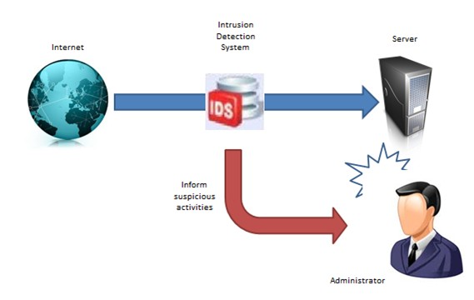

Slide 7
Big Data Analytics in Network Intrusion Detection:
Network flows analysis, logs, and system events has been used for intrusion detection.
Network flows, logs, and system events, etc. generate big data.
It is difficult to analyze this large heterogonous data using traditional methods , so we are trying to implement detection system in Big Data Analytics.

Slide 8
Big data technologies are analyzing these heterogeneous datasets at a high speed and transforming security analytics by:
Capturing large scale data from numerous internal and external sources such as vulnerability databases.
Conducting deep analytics on the data.
Achieving real-time analysis of stream data.
Presenting an integrated view of security-related information.

Slide 9
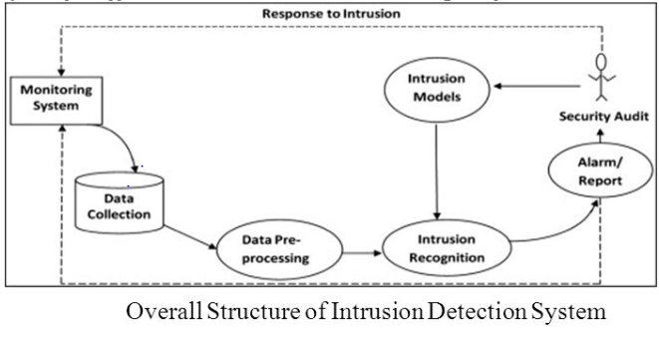
Intrusion detection in big data:

Slide 10


